Slide 1

AI and Blockchain-Based System for Visual Quality Grading and Traceability of Apples in Supply Chains
Vishwakarma Institute of Technology Pune
Department of CSE(AIML)
Guide :Dr. Varsha Dange
Students Names :
Abhinandan Bardia, CSE(AIML)-A, 07
Abhishek Patil, CSE(AIML)-A, 08
Aditi Patil, CSE(AIML)-A, 12
Aditya Kachwaha, CSE(AIML)-A, 14
Ved Aghav, CSE(AIML)-A, 18

Slide 2
Content
Introduction
Motivation
Literature Review
Problem Statement
Objectives
Proposed Methodology or System Design
Tools/Technology Used
Project Flow Diagram
Algorithms
Results and Discussion
Conclusion
References:

Slide 3
Introduction
Fruit grading is traditionally manual, inconsistent, and subjective.
This leads to losses in quality assessment and supply chain inefficiencies.
Artificial Intelligence (AI) combined with Blockchain can provide an automated, transparent, and tamper-proof solution.
In this project, we trained a CNN-based model to classify fruits into Grade A (Fresh), Grade B (Medium), and Grade C (Rotten).
This system helps farmers and distributors make faster, data-driven grading decisions, improving overall supply-chain efficiency.

Slide 4
Motivation
India faces ~30% post-harvest loss due to inefficient quality assessment.
Farmers are underpaid due to lack of reliable grading systems.
Consumers demand trust and transparency in food quality.
Integration of Deep Learning and Blockchain ensures both accuracy and trust in fruit supply chains.
Farmers face losses due to improper grading and delayed decay detection.
Manual grading is slow, inconsistent, and subjective.
Reduces food wastage and supports sustainable supply chains.

Slide 5
Literature Review
No | Title (Source, Date) | Project Idea | Tech Stack | Limitations | Our Improvement
1 | 1. Research on Image Recognition and Grading Method of Apple Based on Machine Vision (CEI, 2022) | Apple grading using classical machine vision | Traditional image processing, feature extraction | Lower accuracy on real-world diverse apples; limited deep learning | Use advanced CNN models + blockchain traceability + mobile app ecosystem
2 | 2. Enhanced CNN for Fruit Disease Detection & Grading (IEEE Sensors Journal, 2024) | Detect diseases and grade fruits using CNN + SSDAE-SVM | CNN, SSDAE, SVM | Heavy computation; not optimized for real-time mobile use | Lightweight CNN models + on-device inference + optimized pipeline
3 | 3. Fruit & Vegetable Grading via Transfer Learning (ICACTA, 2023) | Fruit classification using TL models | Transfer Learning (Inception, ResNet) | Limited dataset diversity; overfitting risk | Collect real-farm apple dataset + robust augmentation
4 | 4. Attribute-based Maturity Grading of Mango (ICIIET, 2022) | Maturity detection using handcrafted features | ML models (SVM, KNN) | Manual feature engineering → inconsistent accuracy | Deep CNN model with automatic feature extraction
5 | 5. Precision Grade Classification of Pomegranates (INNOVA, 2024) | Deep learning model for grade-quality classification | CNN, DL frameworks | Focused only on pomegranates; no supply-chain integration | Extend to apple grading + blockchain-based traceability

Slide 6
Literature Review
No | Title (Source, Date) | Project Idea | Tech Stack | Limitations | Our Improvement
6 | Dragon Fruit Grading with Scalable DNNs (IDCIoT, 2025) | Maturity + quality grading | Scalable Deep Neural Networks | High training cost; limited explainability | Use explainable AI + optimized quantized models
7 | CNN Comparison for Muskmelon Grading (ICICKE, 2025) | Compare CNN architectures for fruit grading | VGG, ResNet, DenseNet | Only comparison; no end-to-end system | Build full ecosystem: AI grading + QR traceability + farmer app
8 | FruitQ-GradeX: Explainable Grading (ICRITO, 2025) | Explainable deep learning fruit grading | XAI + CNN | Slower inference due to explainability layers | Provide optional explainability mode + faster real-time mode
9 | Fruit Quality Assessment with DenseNet (ICECE, 2022) | CNN-based quality grading | DenseNet | Heavy model unsuitable for edge devices | Use MobileNet/EfficientNet for mobile-friendly grading
10 | Mango Defect Detection Using MobileNetV2 (INNOCOMP, 2024) | Detect defects using compact model | MobileNetV2 | Works only for defect detection, not full grading | Multi-class grading: size, color, defects, maturity + blockchain storage

Slide 7
Problem Statement
AI and Blockchain-Based System for Visual Quality Grading and Traceability of Apple in Supply Chains

Slide 8
Objectives
To develop an automatic fruit grading system (focused on apples) using computer vision and machine learning to assess quality based on color, size, texture, and defects.
To enhance grading accuracy through multi-level verification using CNN-based image analysis combined with domain-specific features.
To implement a blockchain-backed traceability system ensuring transparent, tamper-proof storage of grading results and supply-chain records.
To create a unified grading pipeline that improves efficiency, reduces human error, and provides consistent, scalable quality assessment for farmers and distributors.

Slide 9
Research Gap
Most existing grading systems rely on traditional machine vision, lacking the accuracy of modern deep learning models.
Current solutions do not provide real-time grading capabilities suitable for on-field or mobile use.
Few studies integrate AI grading with blockchain, leaving a gap in secure and transparent quality recordkeeping.
Existing systems rarely offer end-to-end traceability, limiting buyer confidence and supply-chain visibility.
Most research focuses only on classification, without addressing practical deployment for farmers through mobile apps.

Slide 10
Proposed Methodology
Dataset Collection & Preprocessing:
Organized into 3 categories (Fresh, Medium, Rotten).
Applied image resizing (224×224), normalization.
Data Augmentation (flip, rotation, zoom, brightness).
Model Training:
Base model: MobileNetV3 (Transfer Learning).
Optimizer: Adam, Loss: Categorical Cross-Entropy.
Progressive augmentation → improved generalization.
Prediction Phase:
Tested with unseen fruit images.
Model outputs grading label (A, B, C).
Blockchain Exploration:
Designed smart contract structure (AppleID,FramerID grade, timestamp).

Slide 11
Proposed Methodology
Application Development:
Farmer and User role based login.
Farmer can add his farm location, warehouse location, and some personal details including his photo and signature.
Farmer has access to take pictures, the model runs to check the freshness of the fruit and grades to generate a QR code.
The user will be able to scan the QR’s generated by the farmers on each product to recheck them and add/skip a review for that farmers produce.

Slide 12
Technology Used
Datasets: Real fruits Image Dataset (Fresh, Medium, Rotten).
Programming Language for Model Training: Python.
Libraries: TensorFlow/Keras (Deep Learning), OpenCV (Image Preprocessing), NumPy & Pandas (Data Handling), Matplotlib (Visualization).
Blockchain Tools: Remix IDE,Sepolia Ethereum,Metamask,Sepolia POW Faucet,Sepolia Ethersacn
App: React Native and Expo Go
User Database: Supabase

Slide 13
Algorithms
Collect Fruit Images & Metadata
Preprocess Images
Train ML Model for Grading
Create API for Access
Store Reports on Blockchain
Generate Quality Reports
Develop User Interface
Integrate with Mobile
Enable Real-time Updates & Auditing

Slide 14
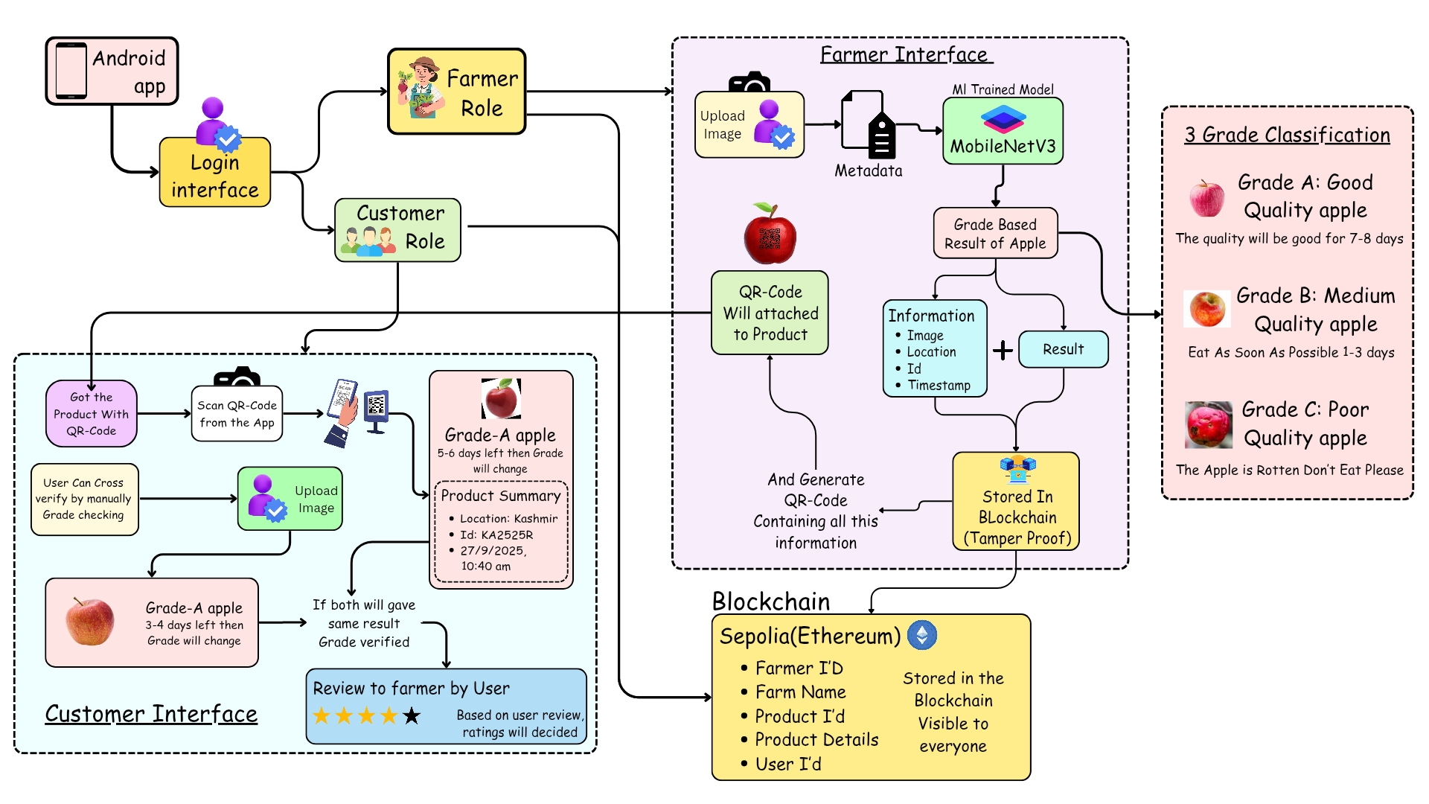
SYSTEM ARCHITECTURE (Grade My Apple)

Slide 15
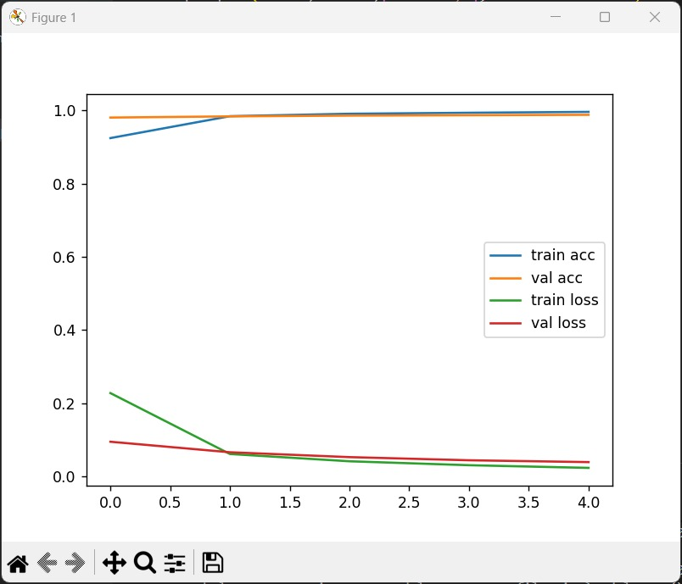
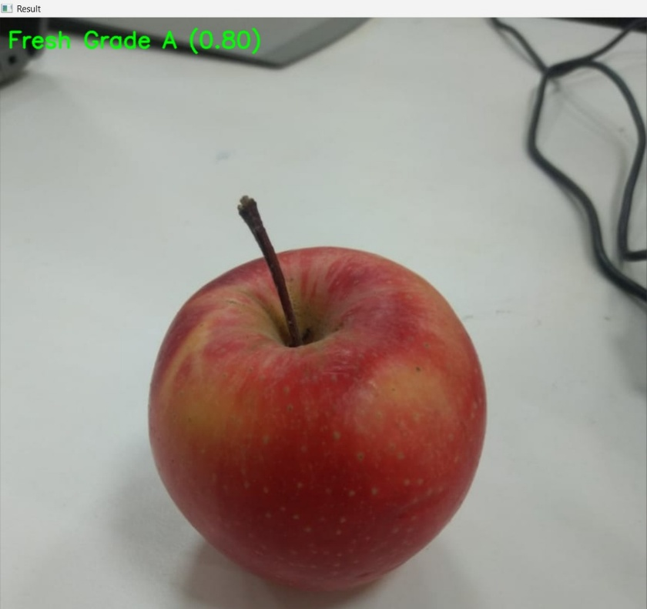
Results and Discussion
Dataset: 3330+ images (3 classes).
Training Accuracy: ~95%
Validation Accuracy: ~88–90% (after augmentation, realistic).
Model successfully classified unseen apple images.
Blockchain structure explored, but full implementation is future scope.

Slide 16
Conclusion
Developed a CNN model to classify apples into Fresh, Medium, Rotten.
Achieved ~88–92% accuracy with data augmentation.
Transfer learning improved results with limited dataset.
Real-time prediction with confidence scores is possible.
Blockchain integration (future) will add traceability & security.
System promotes modern agriculture, fair trade, and consumer trust.

Slide 17
References
[1] J. Peng, J. Li, X. Li, L. Fang, P. Zhang, and Y. Lv, “Research on Image Recognition and Grading Method of Apple Based on Machine Vision,” in 2022 2nd International Conference on Computer Science, Electronic Information Engineering and Intelligent Control Technology (CEI), Nanjing, China, 2022, pp. 511–515.
[2] H. B. Patel and N. J. Patil, “Enhanced CNN for Fruit Disease Detection and Grading Classification Using SSDAE-SVM for Postharvest Fruits,” IEEE Sensors Journal, vol. 24, no. 5, pp. 6719–6732.
[3] C. Narvekar and M. Rao, “Fruit and Vegetable Grading with Transfer Learning and Convolutional Neural Networks for Better Productivity,” in 2023 International Conference on Advanced Computing Technologies and Applications (ICACTA), Mumbai, India, 2023, pp. 1–5.
[4] S. Kripa and V. Jeyalakshmi, “Attribute-based Maturity Grading of Mango Fruit by Machine Learning,” in 2022 International Conference on Intelligent Innovations in Engineering and Technology (ICIIET), Coimbatore, India, 2022, pp. 329–334.
[5] R. M. Math, N. V. Dharwadkar, V. Sajjanar, and M. N. Deshmukh, “Deep Learning for Precision Grade-Quality Classification of Pomegranates,” in 2024 International Conference on Innovation and Novelty in Engineering and Technology (INNOVA), Vijayapura, India, 2024, pp. 1–6.

Slide 18
References
[6] A. N, D. P, D. V. Shah, and R. Niharika, “Dragon Fruit Maturity Detection and Quality Grading with Scalable Deep Neural Networks,” in 2025 3rd International Conference on Intelligent Data Communication Technologies and Internet of Things (IDCIoT), Bengaluru, India, 2025, pp. 1847–1854.
[7] A. Khannum, D. R, and N. K. S, “Comparative Analysis of Convolution Neural Network Models for Automated Grading of Muskmelons,” in 2025 International Conference on Intelligent Computing and Knowledge Extraction (ICICKE), Bengaluru, India, 2025, pp. 1–7.
[8] S. Dutta, S. G. Neogi, D. Chanda, A. Pramanik, Ö. Girgin, and E. L. Öncül, “FruitQ-GradeX: Determining Fruit Quality and Grading with Explainable Deep Learning,” in 2025 12th International Conference on Reliability, Infocom Technologies and Optimization (ICRITO), Noida NCR, India, 2025, pp. 1–7.
[9] M. S. Morshed, S. Ahmed, T. Ahmed, M. U. Islam, and A. B. M. Ashikur Rahman, “Fruit Quality Assessment with Densely Connected Convolutional Neural Network,” in 2022 12th International Conference on Electrical and Computer Engineering (ICECE), Dhaka, Bangladesh, 2022, pp. 1–4.
[10] M. S. R. Kona, A. Guvvala, V. V. L. Eedara, M. S. Gowri, and V. Aluri, “Mango Fruit Defect Detection Using MobileNetV2,” in 2024 International Conference on Emerging Innovations and Advanced Computing (INNOCOMP), Sonipat, India, 2024, pp. 22–27.

Slide 19
Thank You

